Slide 1


Slide 2

Information security
Presented by:
Muneeb Ali (10)
Saad Jamshaid (18)
Muhammad Asad (53)
Inza Shahid ()
Mishkat ()

Slide 3




OUTLINES
1
2
3
4
5
Tool
Introduction
MITRE
ATT&Ck
Mapping
OSI Layer
Mapping
Tool
Use Cases
Mitigation
Strategies

Slide 4



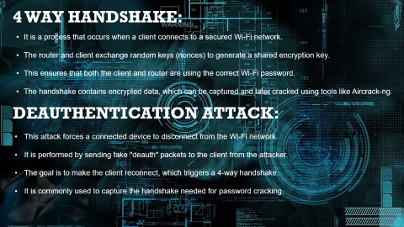


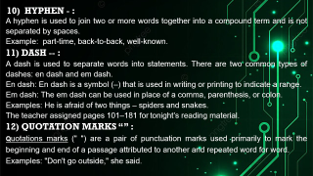



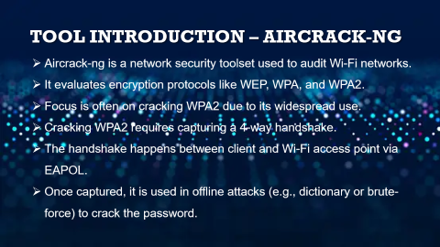

Tool Introduction – Aircrack-ng
Notes:
https://duotone.shapefactory.co/?i=-HH3cGeAC4o&f=3fc7ff&t=2c0058&q=_
https://duotone.shapefactory.co/?f=3fc7ff&t=2c0058&q=_

Slide 5



Notes:
https://duotone.shapefactory.co/?i=-HH3cGeAC4o&f=3fc7ff&t=2c0058&q=_
https://duotone.shapefactory.co/?f=3fc7ff&t=2c0058&q=_

Slide 6

Tool Introduction – Aircrack-ng
Aircrack-ng is a network security toolset used to audit Wi-Fi networks.
It evaluates encryption protocols like WEP, WPA, and WPA2.
Focus is often on cracking WPA2 due to its widespread use.
Cracking WPA2 requires capturing a 4-way handshake.
The handshake happens between client and Wi-Fi access point via EAPOL.
Once captured, it is used in offline attacks (e.g., dictionary or brute-force) to crack the password.
Notes:
https://storyset.com/illustration/meditation/bro
https://duotone.shapefactory.co/?i=-HH3cGeAC4o&f=3fc7ff&t=2c0058&q=_

Slide 7

4 way HANDsHAKE:
It is a process that occurs when a client connects to a secured Wi-Fi network.
The router and client exchange random keys (nonces) to generate a shared encryption key.
This ensures that both the client and router are using the correct Wi-Fi password.
The handshake contains encrypted data, which can be captured and later cracked using tools like Aircrack-ng.
Deauthentication Attack:
This attack forces a connected device to disconnect from the Wi-Fi network.
It is performed by sending fake "deauth" packets to the client from the attacker.
The goal is to make the client reconnect, which triggers a 4-way handshake.
It is commonly used to capture the handshake needed for password cracking.
Notes:
https://duotone.shapefactory.co/?i=roZgc7SXXmI&f=3fc7ff&t=2c0058&q=_

Slide 8

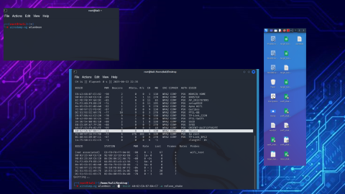
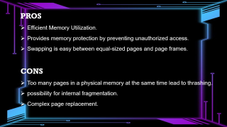
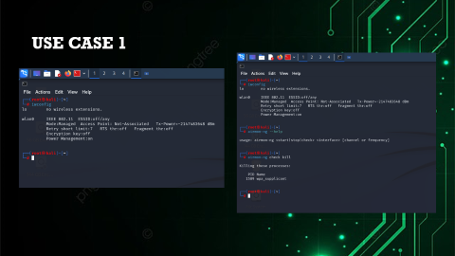
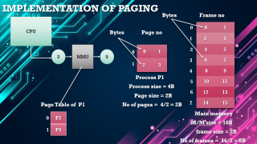
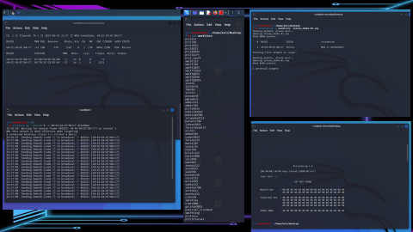
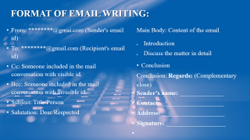
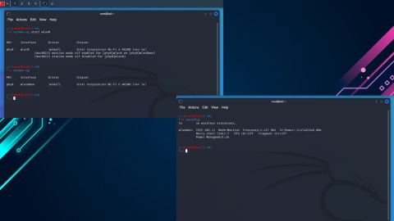
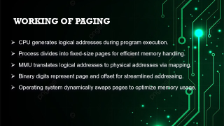
TOOL USE CASES
Notes:
https://duotone.shapefactory.co/?i=-HH3cGeAC4o&f=3fc7ff&t=2c0058&q=_
https://duotone.shapefactory.co/?f=3fc7ff&t=2c0058&q=_

Slide 9



Notes:
https://duotone.shapefactory.co/?i=-HH3cGeAC4o&f=3fc7ff&t=2c0058&q=_
https://duotone.shapefactory.co/?f=3fc7ff&t=2c0058&q=_

Slide 10

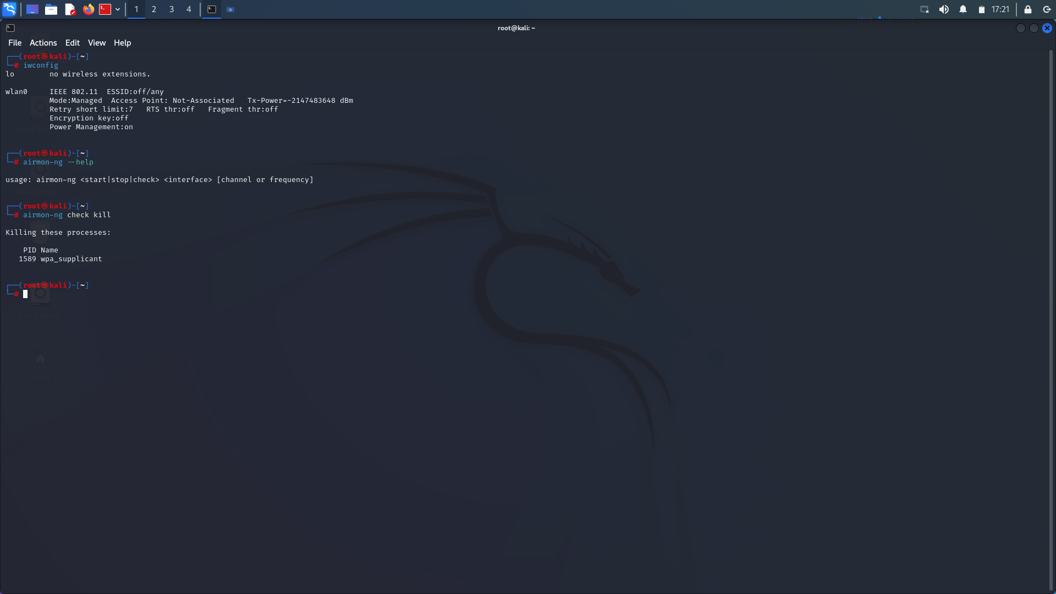
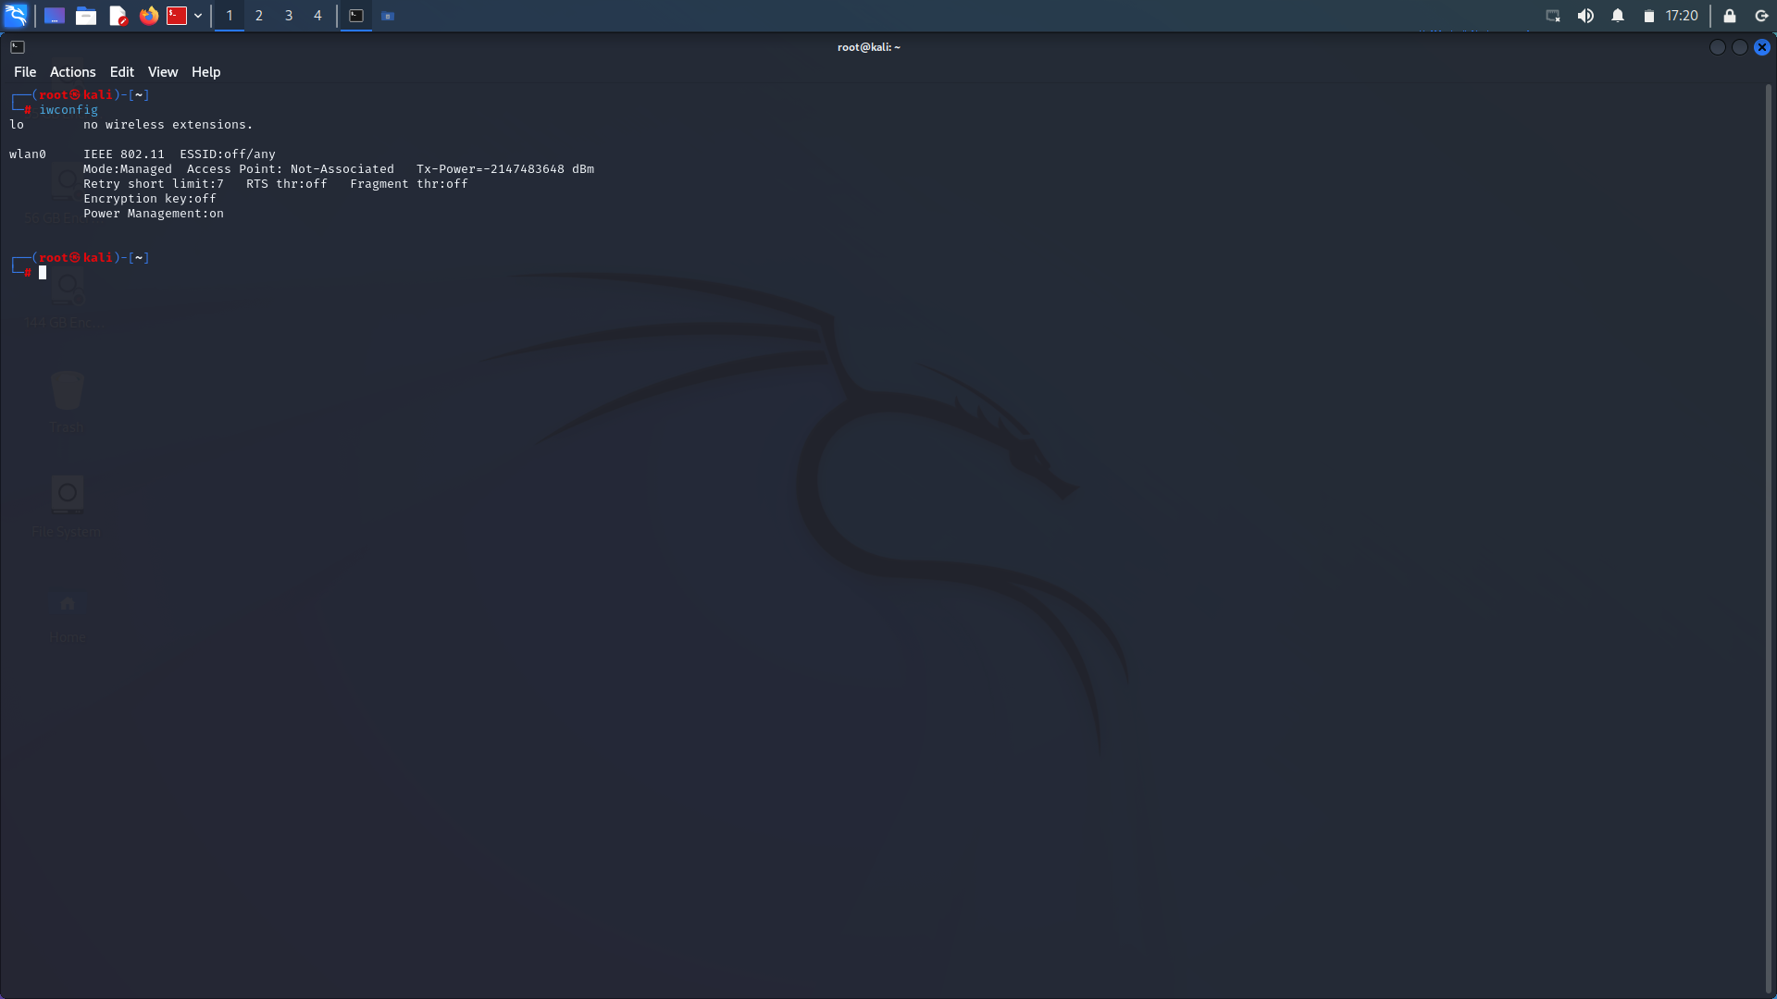
Use case 1
Notes:
https://duotone.shapefactory.co/?i=roZgc7SXXmI&f=3fc7ff&t=2c0058&q=_

Slide 11

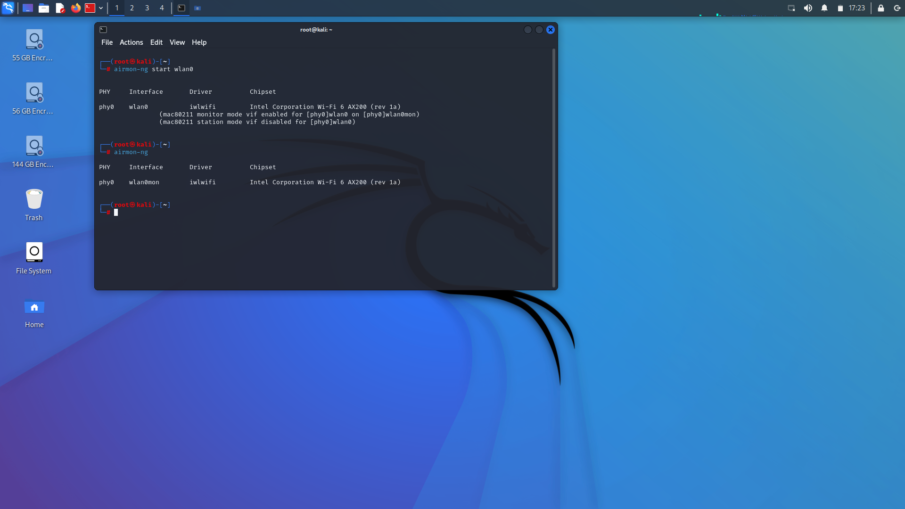

Notes:
https://duotone.shapefactory.co/?i=phIFdC6lA4E&f=3fc7ff&t=2c0058&q=_

Slide 12

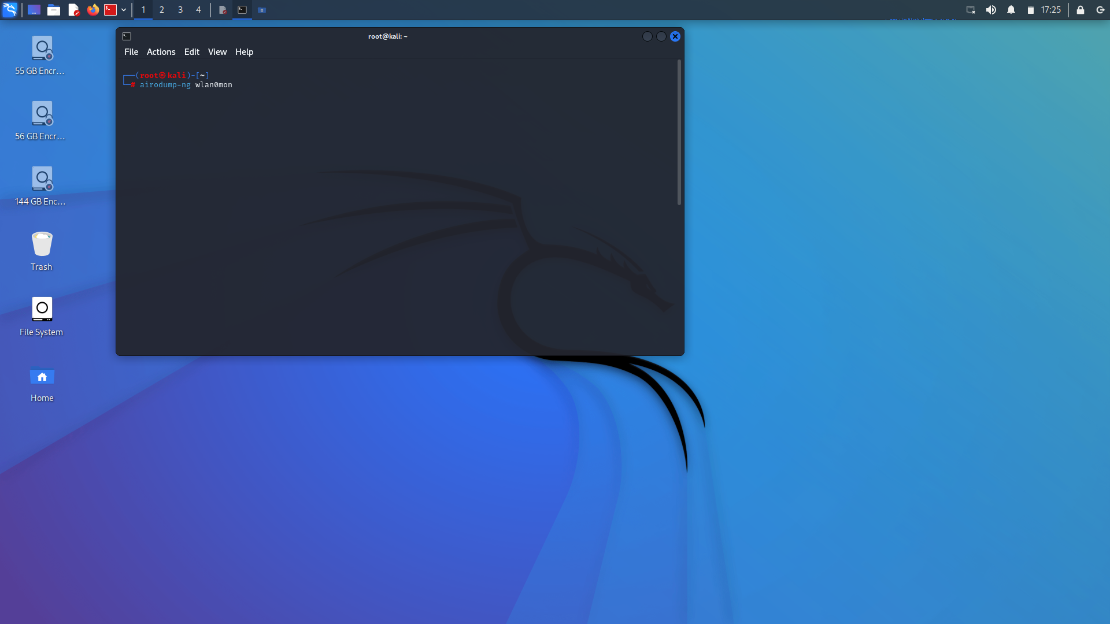
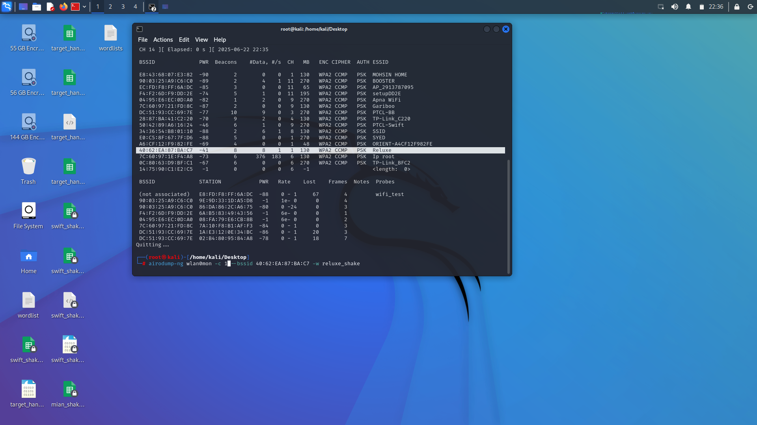

Slide 13

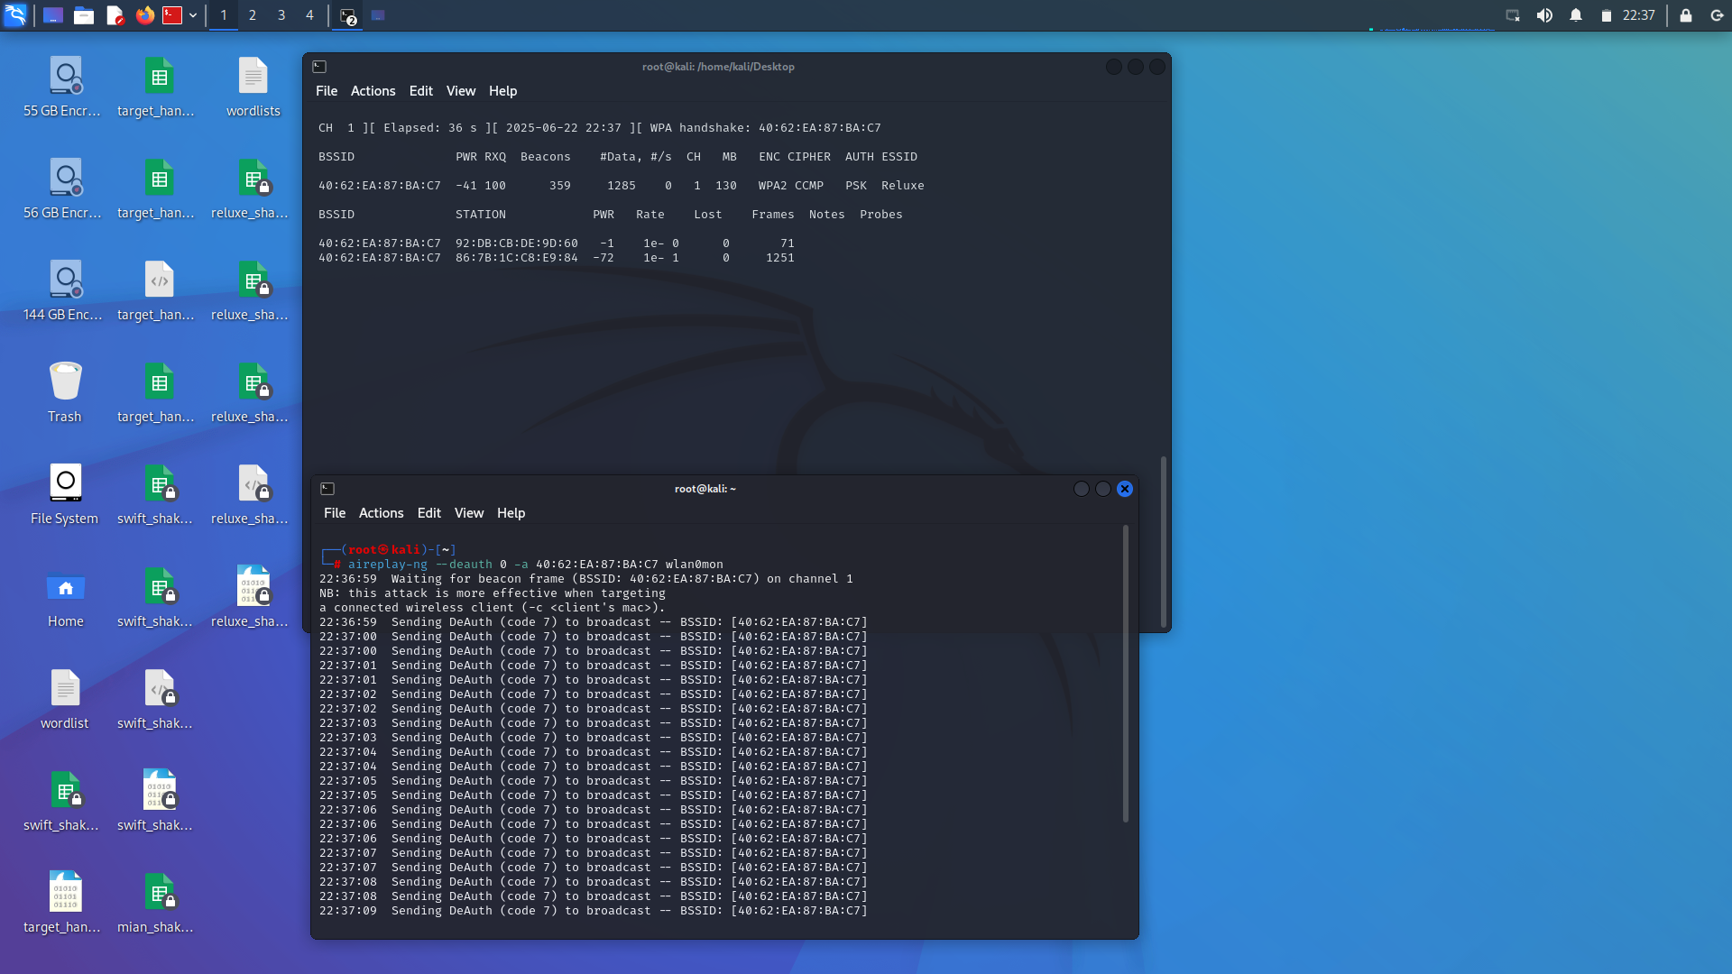
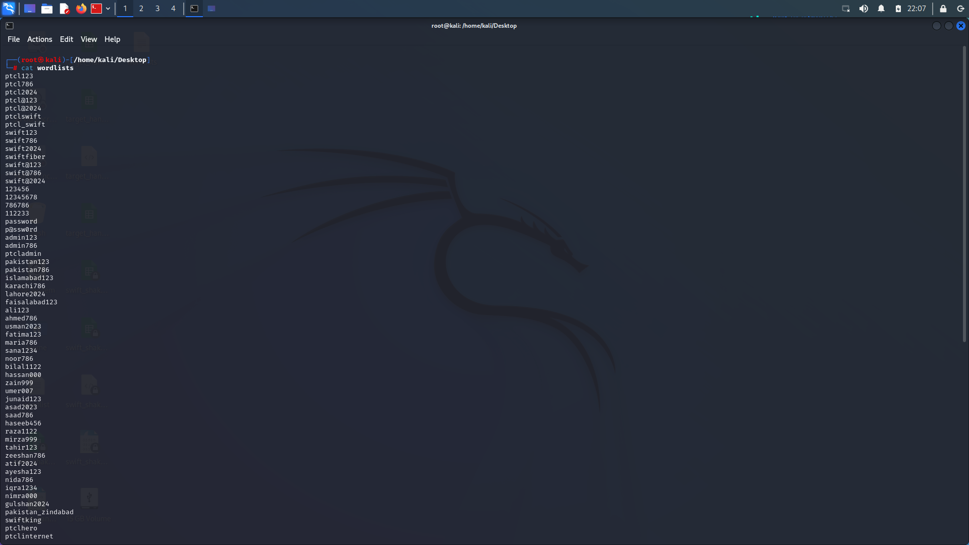
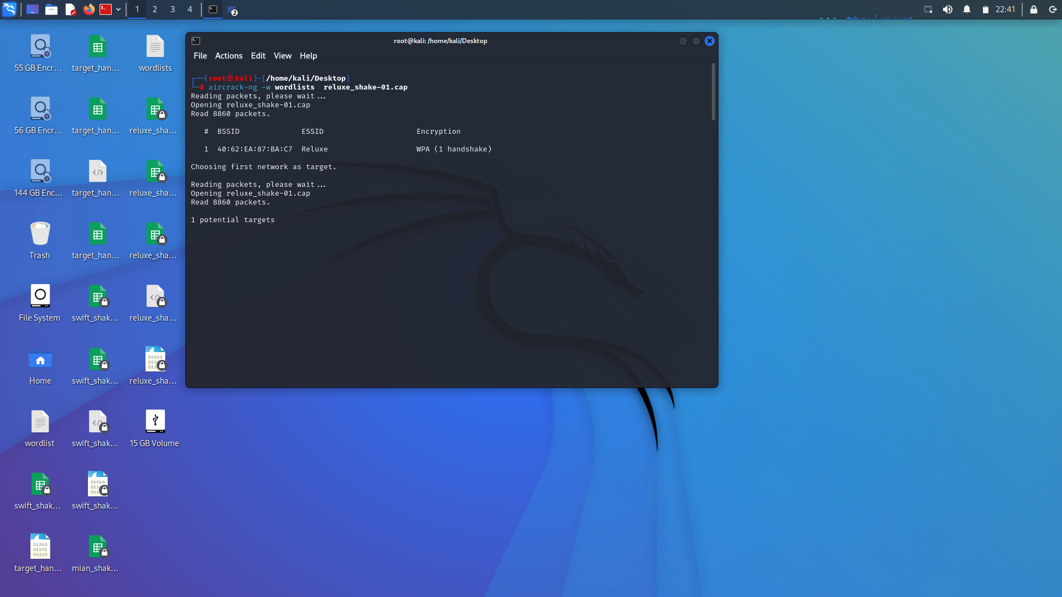
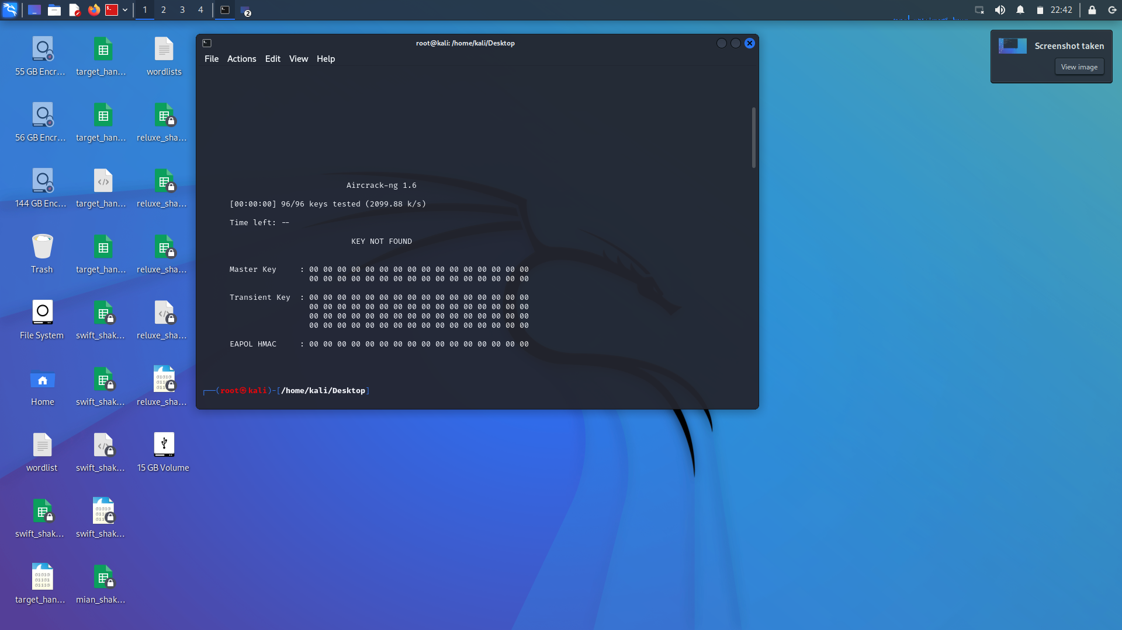

Slide 14

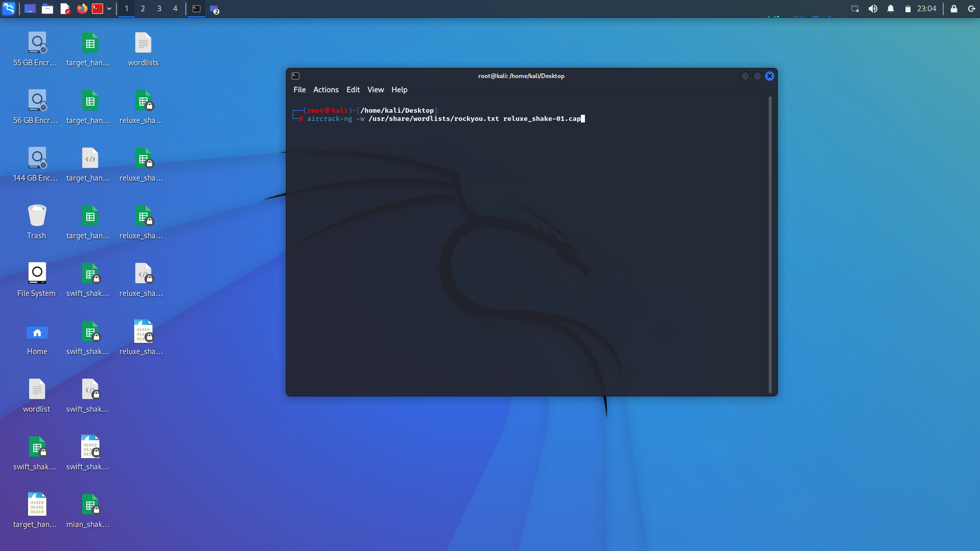
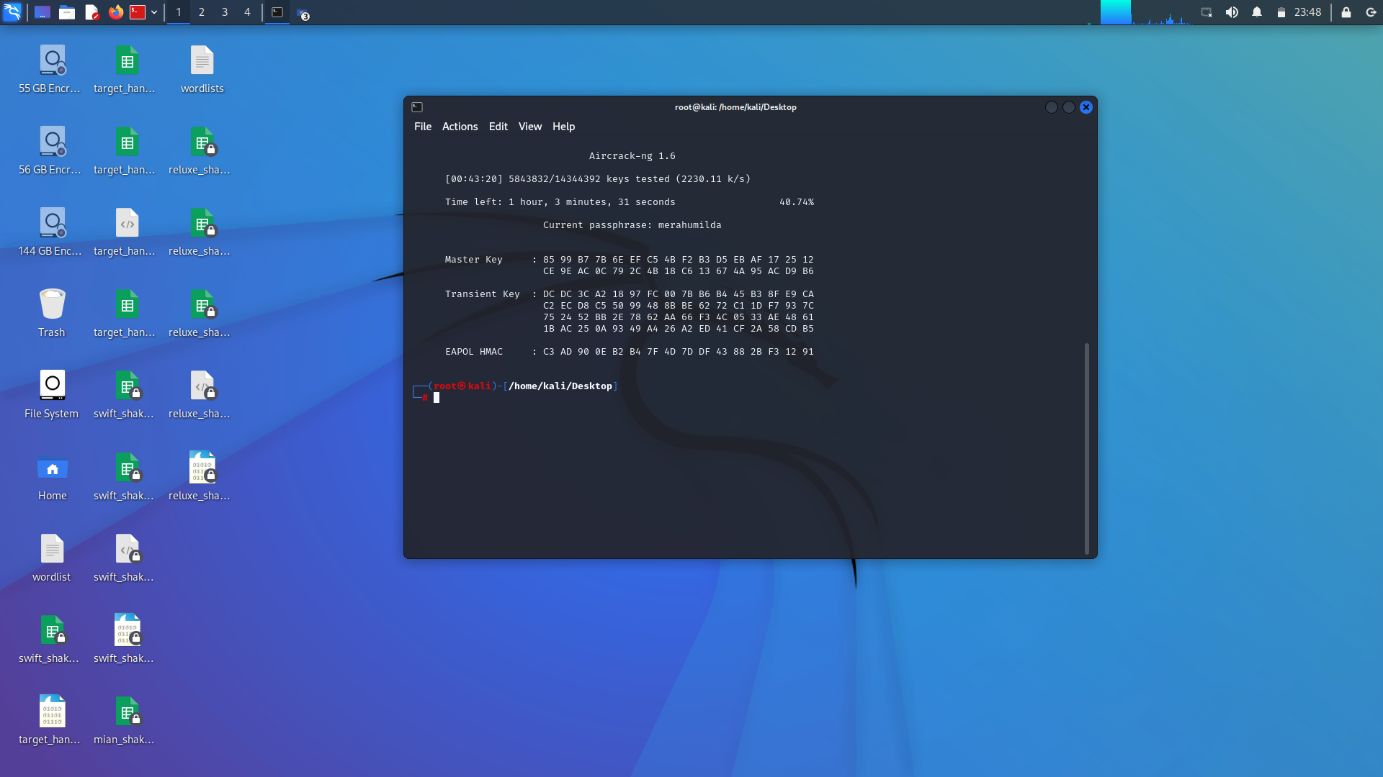
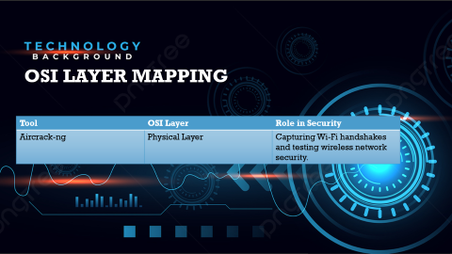

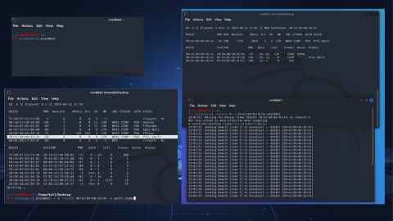

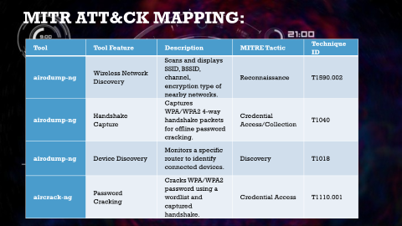

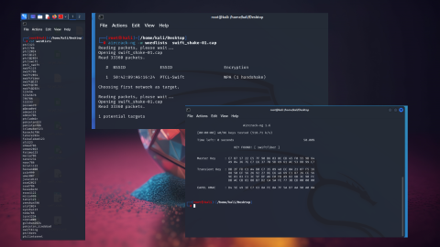
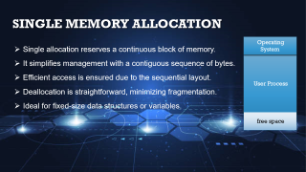
Notes:
https://duotone.shapefactory.co/?i=-HH3cGeAC4o&f=3fc7ff&t=2c0058&q=_
https://duotone.shapefactory.co/?f=3fc7ff&t=2c0058&q=_

Slide 15


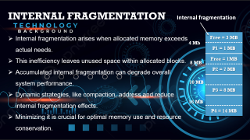

Use case 2
Notes:
https://duotone.shapefactory.co/?i=-HH3cGeAC4o&f=3fc7ff&t=2c0058&q=_
https://duotone.shapefactory.co/?f=3fc7ff&t=2c0058&q=_

Slide 16

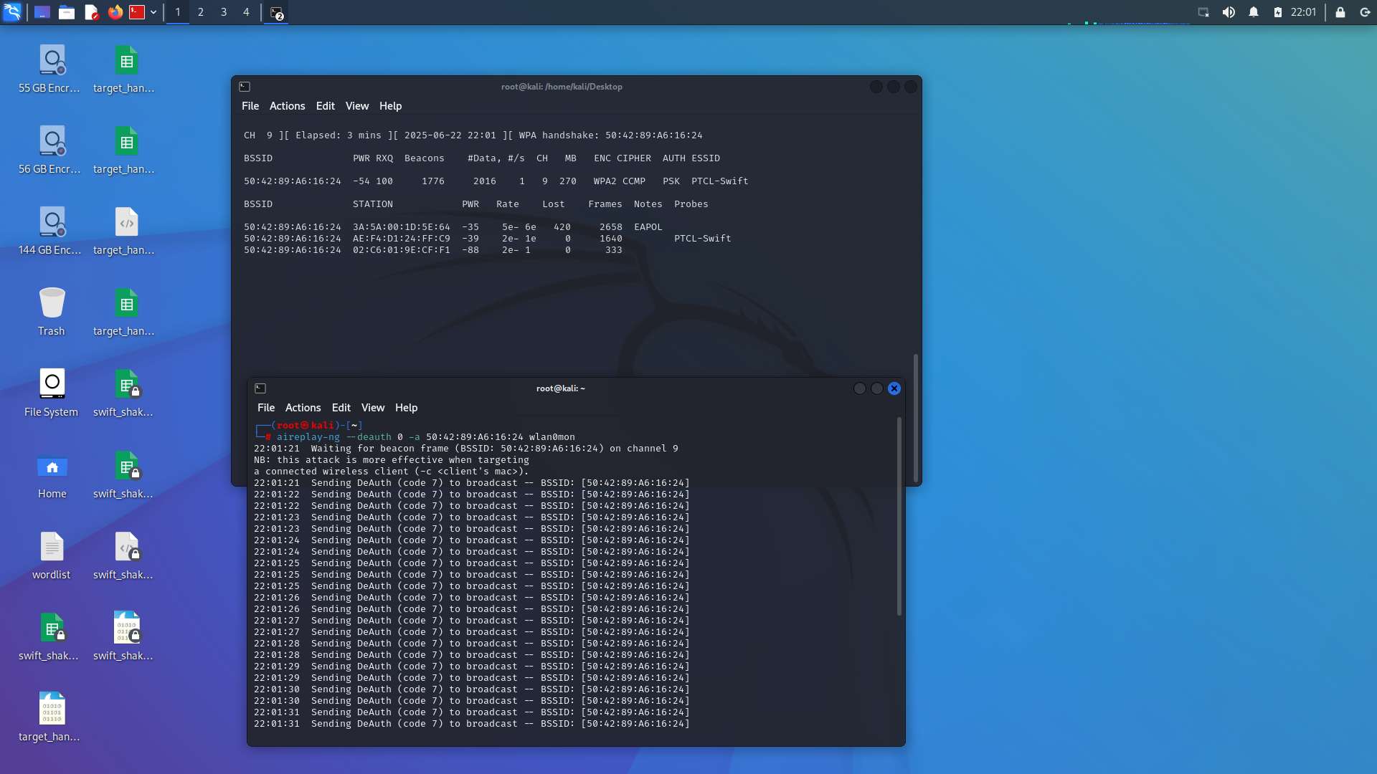
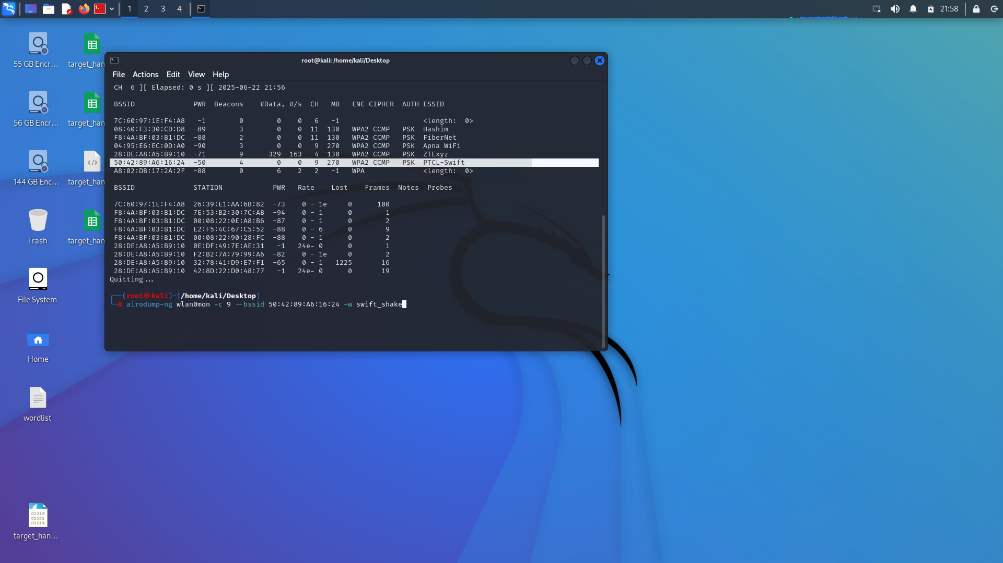
Operating System
User Process
free space
Notes:
https://storyset.com/illustration/meditation/bro
https://duotone.shapefactory.co/?i=-HH3cGeAC4o&f=3fc7ff&t=2c0058&q=_

Slide 17

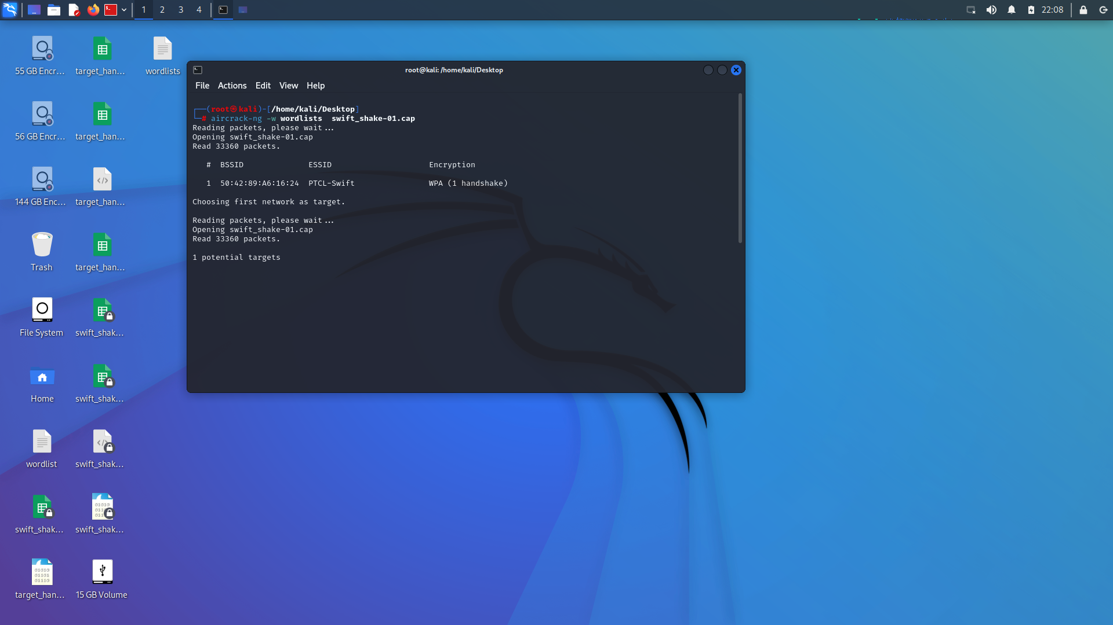
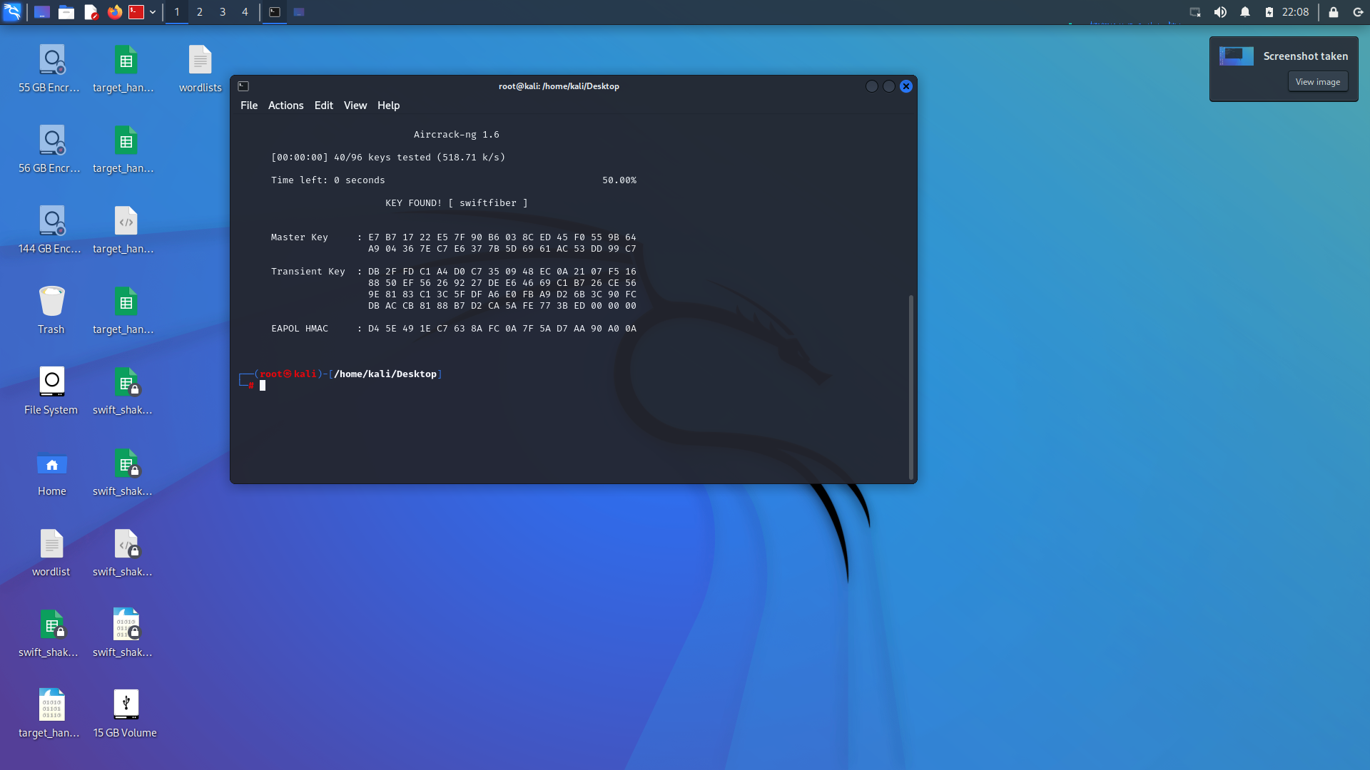
Notes:
https://duotone.shapefactory.co/?i=roZgc7SXXmI&f=3fc7ff&t=2c0058&q=_

Slide 18

OSI LAYER MAPPING
Tool | OSI Layer | Role in Security
Aircrack-ng | Physical Layer | Capturing Wi-Fi handshakes and testing wireless network security.
Notes:
https://duotone.shapefactory.co/?i=phIFdC6lA4E&f=3fc7ff&t=2c0058&q=_

Slide 19

MITR ATT&CK Mapping:
Tool | Tool Feature | Description | MITRE Tactic | Technique ID
airodump-ng | Wireless Network Discovery | Scans and displays SSID, BSSID, channel, encryption type of nearby networks. | Reconnaissance | T1590.002
airodump-ng | Handshake Capture | Captures WPA/WPA2 4-way handshake packets for offline password cracking. | Credential Access/Collection | T1040
airodump-ng | Device Discovery | Monitors a specific router to identify connected devices. | Discovery | T1018
aircrack-ng | Password Cracking | Cracks WPA/WPA2 password using a wordlist and captured handshake. | Credential Access | T1110.001

Slide 20

Mitigation Strategies:
Mitigation Strategy | Description
Use Strong Encryption (WPA3) | Upgrade to WPA3 to resist brute-force and dictionary attacks.
Regularly Change Wi-Fi Passwords | Change passwords periodically to reduce risk of long-term compromise.
Monitor Wi-Fi Access Logs | Regularly check who is connecting and at what times.
Enable MAC Address Filtering | Allow only known devices by filtering their MAC addresses.
Detect Deauthentication Attacks | Use tools or routers that can identify and block disconnect (deauth) attempts.

Slide 21


Notes:
https://duotone.shapefactory.co/?i=phIFdC6lA4E&f=3fc7ff&t=2c0058&q=_

Slide 22

THANK YOU

